Slide 1
Chapter
1
Business Information Systems in Your Career
Notes:
There are two video cases available for this chapter:
Business Information Systems in Your Career
Case 1 UPS Global Operations with the DIAD IV
Case 2 IBM, Cisco, Google: Global Warming by Computer

Slide 2
Essentials of Management Information Systems
Chapter 1 Business Information Systems in Your Career
The Role of Information Systems in Business Today
What’s New in MIS?
New technologies
Cloud computing
Software as a service (SaaS)
Mobile digital platform
People and behavior changes
Managers use social networks, collaboration.
Employees have access to powerful decision aids.
Virtual meetings are accepted and used.
Organizations
Web 2.0 applications widely adopted
Telework gains momentum
Co-creation of value, collaboration across firms

Slide 3
Essentials of Management Information Systems
Chapter 1 Business Information Systems in Your Career
The Role of Information Systems in Business Today
Globalization Challenges and Opportunities:
A Flattened World
Internet and global communications have greatly reduced economic and cultural advantages of developed countries.
  Challenge:
        New Competition environment
  Opportunities:
        New Customers
        Opening new markets easier and faster

Slide 4
Essentials of Management Information Systems
Chapter 1 Business Information Systems in Your Career
The Role of Information Systems in Business Today
Business Drivers of Information Systems
Businesses invest in IT to achieve six important business objectives.
  Operational excellence
  New products, services, and business models
  Customer and supplier intimacy
  Improved decision making
  Competitive advantage
  Survival

Slide 5
Essentials of Management Information Systems
Chapter 1 Business Information Systems in Your Career
The Role of Information Systems in Business Today
Operational Excellence:
Improved efficiency results in higher profits.
Information systems and technologies help improve efficiency and productivity.
  Example: Wal-Mart
    Power of combining information systems and best business practices to achieve operational efficiency—and over $400 billion in sales in 2008
    Most efficient store in world as result of digital links between suppliers and stores

Slide 6
Essentials of Management Information Systems
Chapter 1 Business Information Systems in Your Career
The Role of Information Systems in Business Today
New Products, Services, and Business Models:
Information systems and technologies enable firms to create new products, services, and business models.
  Business model: how a company produces, delivers, and sells its products and services
Example: Music industry
  Drastic changes in business models in recent years
  Apple: Successful innovations—iPod, iPhone, and so on

Slide 7

Essentials of Management Information Systems
Chapter 1 Business Information Systems in Your Career
The Role of Information Systems in Business Today
New Products, Services, and Business Models:
With its stunning multitouch
display, full Internet browsing, digital camera, and portable
music player, Apple’s iPhone has set a new standard for mobile phones. Other Apple products have transformed the music and entertainment industries.

Slide 8
Essentials of Management Information Systems
Chapter 1 Business Information Systems in Your Career
The Role of Information Systems in Business Today
Customer and Supplier Intimacy:
Customers who are served well become repeat customers who purchase more.
  Mandarin Oriental hotel
    Uses IT to foster an intimate relationship with its customers, keeping track of preferences, and so on
Close relationships with suppliers result in lower costs.
  JCPenney
    IT to enhance relationship with supplier in Hong Kong

Slide 9
Essentials of Management Information Systems
Chapter 1 Business Information Systems in Your Career
The Role of Information Systems in Business Today
Improved Decision Making:
If managers rely on forecasts, best guesses, and luck, they will misallocate employees, services, and inventory.
Real-time data improves ability of managers to make decisions.
  Verizon: Web-based digital dashboard to update managers with real-time data on customer complaints, network performance, and line outages

Slide 10
Essentials of Management Information Systems
Chapter 1 Business Information Systems in Your Career
The Role of Information Systems in Business Today
Competitive Advantage:
Often results from achieving previous business objectives
Advantages over competitors:
  Charging less for superior products, better performance, and better response to suppliers and customers
  Toyota: uses TPS (Toyota Production System) to achieve high levels of efficiency and quality

Slide 11
Essentials of Management Information Systems
Chapter 1 Business Information Systems in Your Career
The Role of Information Systems in Business Today
Survival:
Businesses may need to invest in information systems out of necessity; simply the cost of doing business.
  Keeping up with competitors
    Citibank’s introduction of ATMs
  Federal and state regulations and reporting requirements
    Toxic Substances Control Act and the Sarbanes-Oxley Act

Slide 12
Essentials of Management Information Systems
Chapter 1 Business Information Systems in Your Career
Perspectives on Information Systems and Information Technology
What Is an Information System?
Information technology: the hardware and software a business uses to achieve objectives.
Information system: interrelated components that manage information to:
  Support decision making and control.
  Help with analysis, visualization, and product creation.
Data: streams of raw facts.
Information: data shaped into meaningful, useful form.

Slide 13
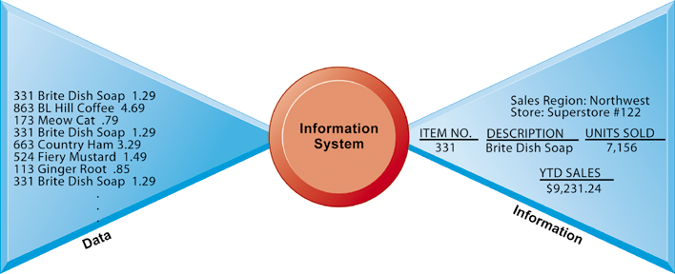
Essentials of Management Information Systems
Chapter 1 Business Information Systems in Your Career
It Isn’t Simply Technology: The Role of People and Organizations
Data and Information
Raw data from a supermarket checkout counter can be processed and organized to produce meaningful information, such as the total unit sales of dish detergent or the total sales revenue from dish detergent for a specific store or sales territory.
Figure 1-1

Slide 14
Essentials of Management Information Systems
Chapter 1 Business Information Systems in Your Career
Perspectives on Information Systems and Information Technology
What Is an Information System?
Activities in an information system that produce information:
  Input
  Processing
  Output
  Feedback
Sharp distinction between computer and computer program versus information system

Slide 15
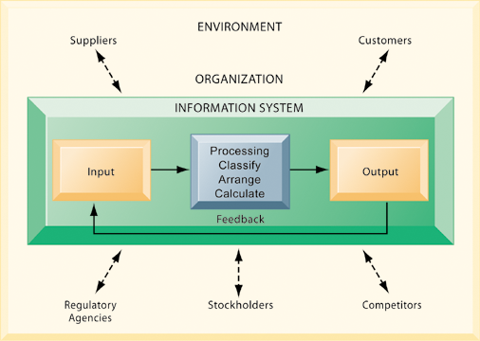
Essentials of Management Information Systems
Chapter 1 Business Information Systems in Your Career
It Isn’t Simply Technology: The Role of People and Organizations
Functions of an Information System
An information system contains information about an organization and its surrounding environment. Three basic activities—input, processing, and output—produce the information organizations need. Feedback is output returned to appropriate people or activities in the organization to evaluate and refine the input. Environmental actors, such as customers, suppliers, competitors, stockholders, and regulatory agencies, interact with the organization and its information systems.
Figure 1-2

Slide 16
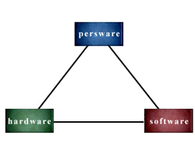
Essentials of Management Information Systems
Chapter 1 Business Information Systems in Your Career
It Isn’t Simply Technology: The Role of People and Organizations
The Role of People and Organizations
Information systems literacy
  Includes behavioral and technical approach
Computer literacy
  Focuses mostly on knowledge of IT
Management information systems (MIS)
  Focuses on broader information systems literacy
  Issues surrounding development, use, impact of information systems used by managers and employees

Slide 17
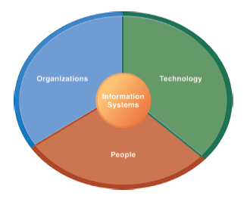
Essentials of Management Information Systems
Chapter 1 Business Information Systems in Your Career
It Isn’t Simply Technology: The Role of People and Organizations
Information Systems Are More than Computers
Using information systems effectively requires an understanding of the organization, people, and information technology shaping the systems. An information system provides a solution to important business problems or challenges facing the firm.
Figure 1-3

Slide 18
Essentials of Management Information Systems
Chapter 1 Business Information Systems in Your Career
It Isn’t Simply Technology: The Role of People and Organizations
Dimensions of Information Systems
Organizations
  Coordinate work through structured hierarchy and business processes.
    Business processes: related tasks and behaviors for accomplishing work
      Examples: fulfilling an order, hiring an employee
      May be informal or include formal rules
  Culture embedded in information systems
    Example: UPS’s concern with placing service to customer first

Slide 19
Essentials of Management Information Systems
Chapter 1 Business Information Systems in Your Career
It Isn’t Simply Technology: The Role of People and Organizations
Dimensions of Information Systems
People
  Information systems require skilled people to build, maintain, and use them.
  Employee attitudes affect ability to use systems productively.
  Role of managers
    Perceive business challenges.
    Set organizational strategy.
    Allocate human and financial resources.
    Creative work: new products, services.

Slide 20
Essentials of Management Information Systems
Chapter 1 Business Information Systems in Your Career
It Isn’t Simply Technology: The Role of People and Organizations
Dimensions of Information Systems
Technology
  IT Infrastructure: Foundation or platform that information systems built on
    Computer hardware
    Computer software
    Data management technology
    Networking and telecommunications technology
      Internet and Web, extranets, intranets
      Voice, video communications

Slide 21
Essentials of Management Information Systems
Chapter 1 Business Information Systems in Your Career
Understanding Information Systems: A Business Problem-Solving Approach
The Problem-Solving Approach
Few business problems are simple or straightforward.
Most business problems involve a number of major factors that can fall into three main categories:
  Organization
  Technology
  People

Slide 22
Essentials of Management Information Systems
Chapter 1 Business Information Systems in Your Career
Understanding Information Systems: A Business Problem-Solving Approach
A Model of the Problem-Solving Process
Problem solving: four-step process
  Problem identification
  Solution design
  Choice
  Implementation

Slide 23
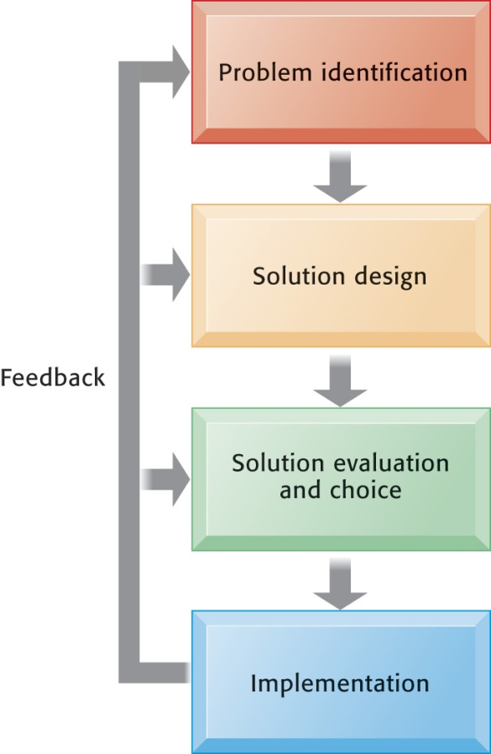
Essentials of Management Information Systems
Chapter 1 Business Information Systems in Your Career
Understanding Information Systems: A Business Problem-Solving Approach
Problem Solving Is a Continuous Four-Step Process
During implementation and thereafter, the outcome must be continually measured and the information about how well the solution is working is fed back to the problem solvers. In this way, the identification of the problem can change over time, solutions can be changed, and new choices made, all based on experience.
Figure 1-4

Slide 24
Essentials of Management Information Systems
Chapter 1 Business Information Systems in Your Career
Understanding Information Systems: A Business Problem-Solving Approach
A Model of the Problem-Solving Process
Problem identification includes:
  Agreement that problem exists
  Definition of problem
  Causes of problem
  What can be done given resources of firm

Slide 25
Essentials of Management Information Systems
Chapter 1 Business Information Systems in Your Career
Understanding Information Systems: A Business Problem-Solving Approach
A Model of the Problem-Solving Process
Typical organizational problems
  Outdated business processes
  Unsupportive culture and attitudes
  Political in-fighting
  Turbulent business environment, change
  Complexity of task
  Inadequate resources

Slide 26
Essentials of Management Information Systems
Chapter 1 Business Information Systems in Your Career
Understanding Information Systems: A Business Problem-Solving Approach
A Model of the Problem-Solving Process
Typical technology problems
  Insufficient or aging hardware
  Outdated software
  Inadequate database capacity
  Insufficient telecommunications capacity
  Incompatibility of old systems with new technology
  Rapid technological change

Slide 27
Essentials of Management Information Systems
Chapter 1 Business Information Systems in Your Career
Understanding Information Systems: A Business Problem-Solving Approach
A Model of the Problem-Solving Process
Typical people problems
  Lack of employee training
  Difficulties of evaluating performance
  Legal and regulatory compliance
  Work environment, ergonomics
  Poor or indecisive management
  Lack of employee support and participation

Slide 28
Essentials of Management Information Systems
Chapter 1 Business Information Systems in Your Career
Understanding Information Systems: A Business Problem-Solving Approach
A Model of the Problem-Solving Process
Solution design
  Often many possible solutions
  Consider as many as possible to understand range of solutions
Choice: Factors include
  Cost
  Feasibility given resources and skills
  Length of time needed to implement solution

Slide 29
Essentials of Management Information Systems
Chapter 1 Business Information Systems in Your Career
Understanding Information Systems: A Business Problem-Solving Approach
A Model of the Problem-Solving Process
Implementation
  Building or purchasing solution
  Testing solution, employee training
  Change management
  Measurement of outcomes
  Feedback, evaluation of solution
Problem solving is a continuous process, not a single event
  Sometimes chosen solution doesn’t work or needs adjustment

Slide 30
Essentials of Management Information Systems
Chapter 1 Business Information Systems in Your Career
Understanding Information Systems: A Business Problem-Solving Approach
The Role of Critical Thinking in Problem Solving
Without critical thinking, easy to jump to conclusions, misjudge a problem, and waste resources
Critical thinking:
  Sustained suspension of judgment with an awareness of multiple perspectives and alternatives

Slide 31
Essentials of Management Information Systems
Chapter 1 Business Information Systems in Your Career
Understanding Information Systems: A Business Problem-Solving Approach
The Role of Critical Thinking in Problem Solving
Four elements of critical thinking:
  Maintaining doubt and suspending judgment
  Being aware of different perspectives
    Including technology, organization, and people perspectives
  Testing alternatives and letting experience guide
  Being aware of organizational and personal limitations

Slide 32
Essentials of Management Information Systems
Chapter 1 Business Information Systems in Your Career
Understanding Information Systems: A Business Problem-Solving Approach
The Connection Between Business Objectives, Problems, and Solutions
When firms cannot achieve business objectives these objectives become challenges.
Information systems often present solutions, partially or fully, to these challenges.

Slide 33
Essentials of Management Information Systems
Chapter 1 Business Information Systems in Your Career
Information Systems and Your Career
Success in today’s job market requires a broad set of skills.
Job candidates must have problem-solving skills as well as technical skills so that they can complete specific tasks.
The service sector will account for 95 percent of the new jobs that are created or open up by 2012

Slide 34
Essentials of Management Information Systems
Chapter 1 Business Information Systems in Your Career
Information Systems and Your Career
How Information Systems Will Affect Business Careers
Accounting:
  Accountants increasingly rely on information systems to summarize transactions, create financial records, organize data, and perform financial analysis.
  Skills:
    IT, software used in auditing, accounting functions
    System and network security issues
    Enterprise systems for financial reporting

Slide 35
Essentials of Management Information Systems
Chapter 1 Business Information Systems in Your Career
Information Systems and Your Career
How Information Systems Will Affect Business Careers
Finance:
  Relationship between information systems and financial management and services is so strong that many advise finance majors to co-major in information systems.
  Skills:
    IT, software used by financial managers and financial service firms
    New technologies for financial transactions, trading
    Enterprise systems for financial reporting

Slide 36
Essentials of Management Information Systems
Chapter 1 Business Information Systems in Your Career
Information Systems and Your Career
How Information Systems Will Affect Business Careers
Marketing:
  No field has undergone more technology-driven change in the past five years than marketing and advertising.
  Skills:
    Internet, marketing database systems, and impact on marketing activities (brand development, promotion, sales)
    Enterprise systems for product management, sales force management, customer relationship management

Slide 37
Essentials of Management Information Systems
Chapter 1 Business Information Systems in Your Career
Information Systems and Your Career
How Information Systems Will Affect Business Careers
Operations management in services and manufacturing:
  Industrial production managers, administrative service managers, and operations analysts
  Skills:
    Hardware and software platforms for operations management
    How enterprise systems for production management, supplier management, sales force management, customer relationship management are used to achieve efficient operations and meet other goals

Slide 38
Essentials of Management Information Systems
Chapter 1 Business Information Systems in Your Career
Information Systems and Your Career
How Information Systems Will Affect Business Careers
Management:
  The job of management has been transformed by information systems.
  Skills:
    Hardware and software to improve management, enhance leadership and coordination, improve achievement of overall corporate objectives
    How enterprise systems are used to achieve efficient operations and help make better decisions for improving firm performance

Slide 39

Essentials of Management Information Systems
Chapter 1 Business Information Systems in Your Career
Information Systems and Your Career
The job of management
requires extensive use of information systems to support decision making and to monitor the performance of the firm.

Slide 40

Essentials of Management Information Systems
Chapter 1 Business Information Systems in Your Career
Information Systems and Your Career
How Information Systems Will Affect Business Careers
Equities analysts depend heavily on information systems for organizing and analyzing very large amounts of financial data.

Slide 41
Essentials of Management Information Systems
Chapter 1 Business Information Systems in Your Career
Information Systems and Your Career
How Information Systems Will Affect Business Careers
Information systems:
  Fast changing and dynamic profession because information technologies are among most important tools for achieving business firms’ key objectives
  Domestic and offshore outsourcing
  Skills:
    Uses of new and emerging hardware and software to achieve six business objectives
    An ability to take a leadership role in the design and implementation of new information systems

Slide 42
Essentials of Management Information Systems
Chapter 1 Business Information Systems in Your Career
Information Systems and Your Career
How Information Systems Will Affect Business Careers
Common requirements
  How IT helps achieve six business objectives
  Central role of databases
  Information analysis, impact of environment
  Working with specialists and systems designers
  Ethical, social, legal environment and issues
    Use of IT to meet legal requirements

